Slide 1

SNAKE GAME USING PYGAME MODULE
Submitted by
SINGH SHIVAM JAYPRAKASH (216580316017)
JHA VISHAL RAJKISHOR (216580316034)
SHIRISTI KUMARI PATHAK (216580316038)
SNEHA SHUBHASH BIND (21658316042)
KHUSHI PATEL (216080316026)
UNDER THE GUIDANCE OF
MRS. BHARTI CHATURVEDI

Slide 2
WHAT IS PYGAME?
Pygame is a cross-platform set of Python modules designed for writing video games. It includes computer graphics and sound libraries designed to be used with the Python programming language.

Slide 3
INTRODUCTION ABOUT PROJECT
This is a type of a Snake Game in which The player controls a long, thin creature, resembling a snake, which roams around on a bordered plane, picking up food (or some other item), trying to avoid hitting its own tail or the edges of the playing area. Each time the snake eats a piece of food, its tail grows longer, making the game increasingly difficult. The user controls the direction of the snake's head (up, down, left, or right), and the snake's body follows.

Slide 4
CODE EXPLAINATION
IMPORTED PYGAME MODULE FOR THE PROGRAM
IMPORTED RAMDOM MODULE FOR SNAKE FOOD
IMPORTED RGB FOR USING COLORS IN PROGRAM
IMPORTED JSON IT IS A BUILT – IN PACKAGE FOR STORING AND TRANSFER THE DATA.

Slide 5
Created a game window using pygame Syntax : gameWindow=pygame.display.set_mode((screen_width,screen_height)) Added three different images for different operations. SYNTAX, bgimg = pygame.image.load("snake8.jpg") bgimg = pygame.transform.scale(bgimg, (screen_width,screen_height)).convert_alpha()

Slide 6
Playing audio in pygame by starting the mixer.init(), load the audio syntax: pygame.mixer.music.load(‘audio.mp3') pygame.mixer.music.play() update () to make the display surface actually appear on the users monitor syntax: pygame.display.update()

Slide 7
The game is divided into three part. The first part is welcome page. The second part is game window. Third part is game over. functions are defined in the program, syntax: def text_screen(text,color,x,y):

Slide 8
Created a txt file for storing the high score and opened that txt file in read and write mode in the program for updating the high score in txt file. Syntax: with open ('high_score.txt',"w") as f: f.write("0“) with open("high_score.txt","r") as f: hiscore =f.read()

Slide 9
Many variables are defined for storing elements like snake , snake food , velocity, snake length , head etc. While loop is used for execution of a block statement in program for snake body and it stops executing the program when snake hits its own tail or the edges of the playing area.

Slide 10
Keys event is used for knowing which key is pressed , we have to check the event .key variable corresponds to which pygame keys. Syntax: K_UP (up arrow) K_DOWN (down arrow) K_RIGHT (right arrow) K_LEFT (left arrow) K_SPACE (space bar)

Slide 11
fill() function fills the surface object our screen with colours by passing the parameters. Syntax: surface.fill(white) blit() function draws a source surface onto this surface. The draw can be positioned with the dest argument. X and y are the position inside the window. Syntax: blit(background,(X,Y))

Slide 12
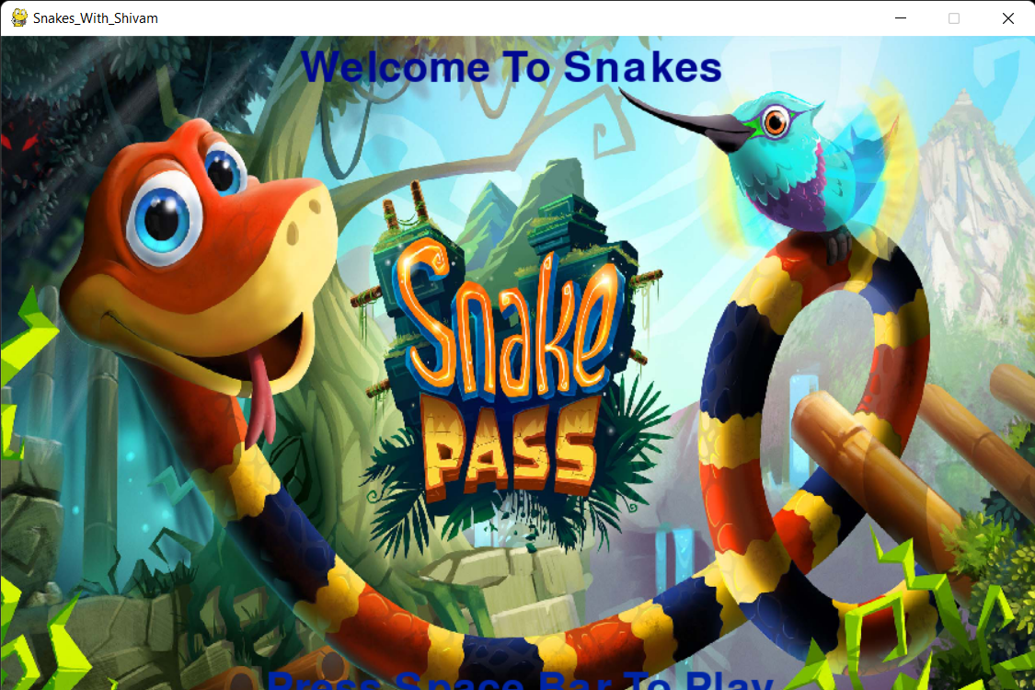
OUTPUT

Slide 13
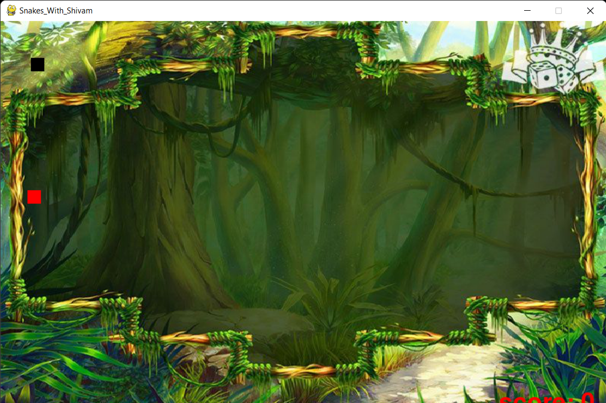

Slide 14
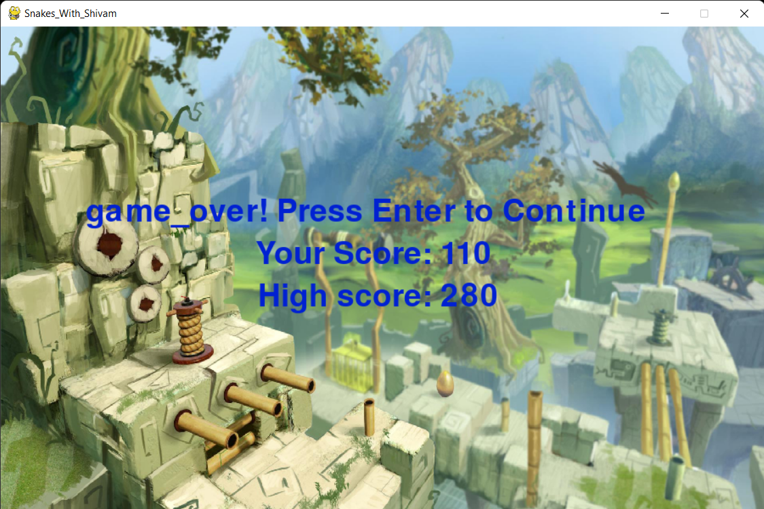

Slide 15
THE END

